Slide 1
Hadoop Overview of technologies and HDFS

Slide 2
Motivations
Addressing PIG, HIVE , Scala, Python, R
PIG and HIVE are native to Apache Hadoop
Scala is a language in its own right – It is also the language used to write Apache Spark
Python , R are extremely popular for data science for a number of reasons -but they are not native ‘big data’ languages and outside of specific implementations such as revolution R are limited to use on a specific machine

Slide 3
Apache hadoop vs Apache Spark
Apache Spark has been hailed as the ‘next gen hadoop’
In many cases it may be slightly more accurate to present it as a compliment to Apache Hadoop – though you can handle similar tasks with either.
Apache Spark supports in memory processing and is better suited to tasks that will require higher memory access
Apache Hadoop is strong in batch processing

Slide 4
HDFS “round trip” : take a text file into hdfs file system and then pull out!

Slide 5
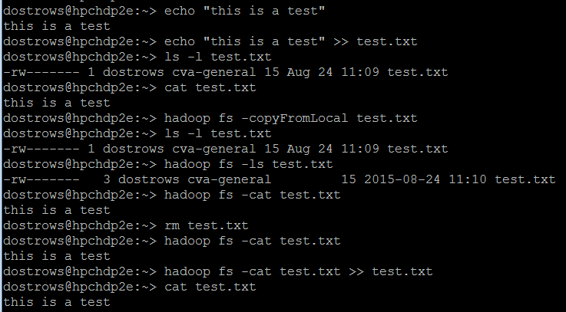

Slide 6
Using Streaming Scripts outside of Hadoop (pp 106) Turkington, Garry. Hadoop Beginner's Guide. Packt Publishing Ltd, 2013.pp106
Python program:
fout = open(“out.dat”,”w”)
for line in sys.stdin:
#postprocess
fout.write(line.split(“,”)[0]) # dump out the first piece of data

Slide 7
How to execute.
cat <hdfs file> | test.py
Will talk more in the python section…

